Slide 1
Combinatorial Pyramids – Development and Lessons Learned
David Pfahler
Structural Pattern Recognition

Slide 2
Outline

Slide 3
Recap Combinatorial Maps

Slide 4
Recap Combinatorial Maps
 | 1 | 2 | 3 | 4
a | 2 | 1 | 4 | 3
s | 4 | 2 | 3 | 1

Slide 5
Recap Combinatorial Maps
 | 1 | 2 | 3 | 4
a | 2 | 1 | 4 | 3
s | 4 | 2 | 3 | 1

Slide 6
Development Phases
Phase 1:
Existing Work
Phase 2:
Meet the Maps
Phase 3:
Implementation
Phase 4:
Results

Slide 7
Development Phases
Phase 1:
Existing Work
Phase 2:
Meet the Maps
Phase 3:
Implementation
Phase 4:
Results

Slide 8


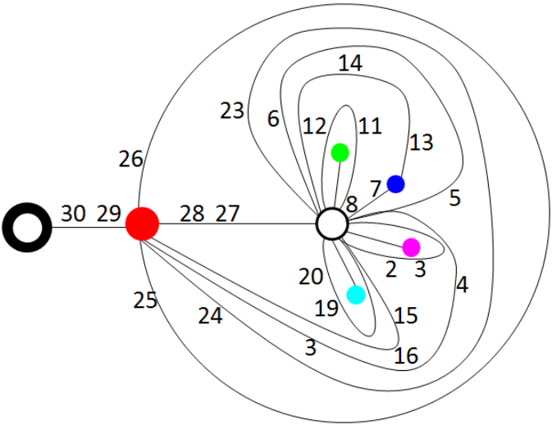
Phase 1: Existing Work
[Tor] is a Technical Report about operations on a Combinatorial Pyramid (CP).
[Tor]

Slide 9
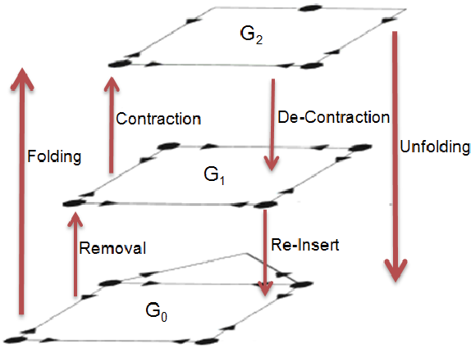
Phase 1: Existing Work
Recap: Operations on a Combinatorial Map (CM):
Remove
Contract
[Tor]

Slide 10
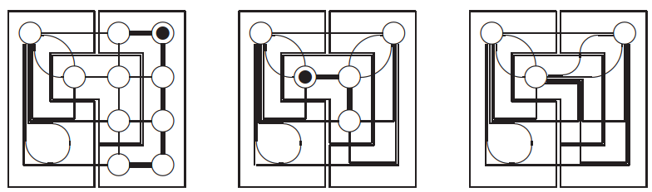
Phase 1: Existing Work
[Bru01] is an introduction to the CP. With background information an the contraction kernel.
[Bru01]

Slide 11
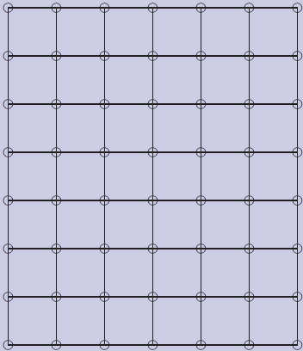
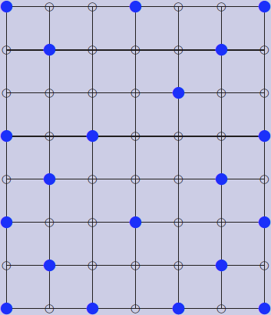
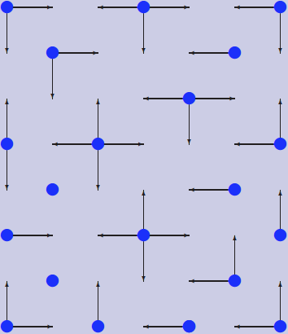
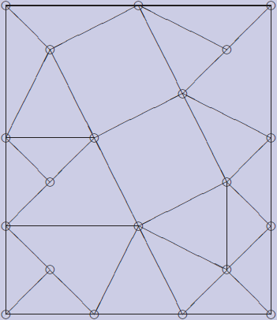
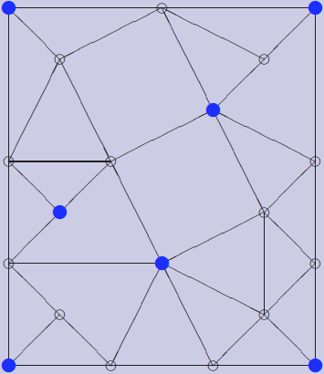
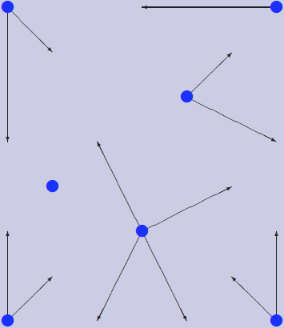
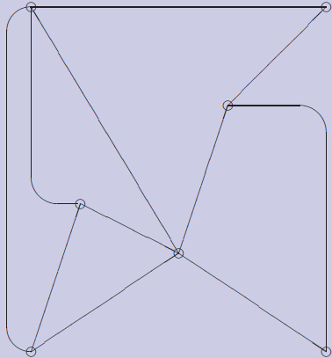
Phase 1: Existing Work
Recap: Contraction Kernel

Slide 12
Phase 1: Existing Work
[Bru03] describes contraction in parallel with contraction kernels
Recap: Problem why parallel contraction/removal is not trivial

Slide 13
Development Phases
Phase 1:
Existing Work
Phase 2:
Meet the Maps
Phase 3:
Implementation
Phase 4:
Results

Slide 14
Phase 2: Meet the Maps
I Implemented a simple python class for CM Not for computations but for representations
import CombinatorialMap
map=CombinatorialMap()
map.setSize(5, 5)
map.printNodes()

Slide 15
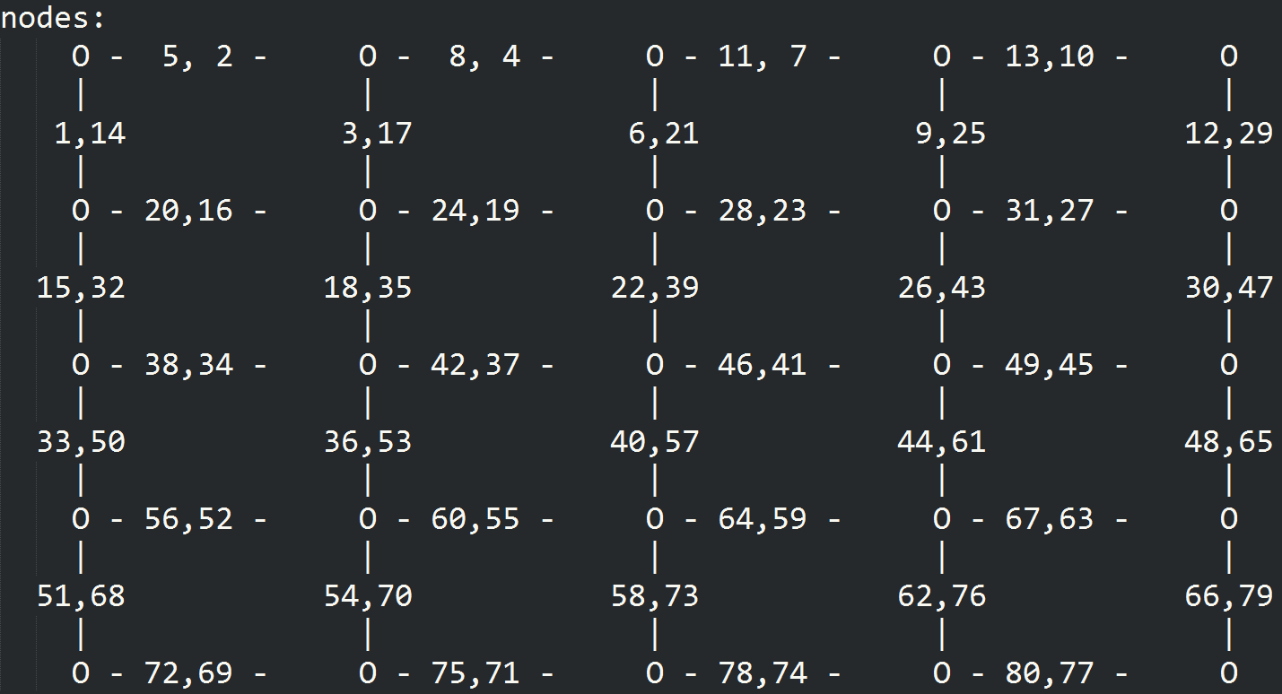
Phase 2: Meet the Maps

Slide 16
Phase 2: Meet the Maps
Also created functions to receive:
All darts with specific direction
All involutions of specific darts
The orbit of a vertex
All next darts
…

Slide 17
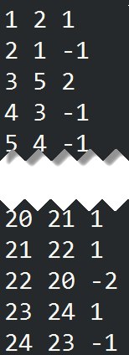
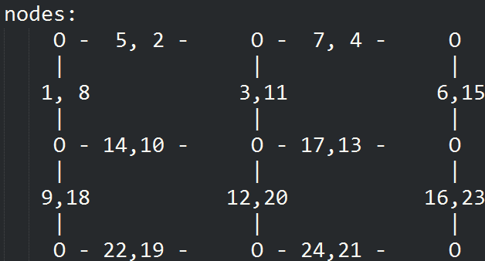
Phase 2: Meet the Maps
These are used to understand and create a CM from an image
d | s(d) | s(d)-d

Slide 18
Development Phases
Phase 1:
Existing Work
Phase 2:
Meet the Maps
Phase 3:
Implementation
Phase 4:
Results

Slide 19
Phase 3: Implementation

Slide 20
Phase 3: Implementation

Slide 21
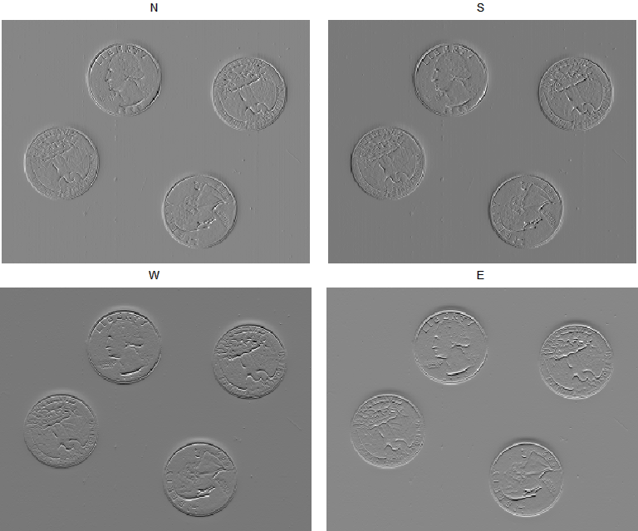
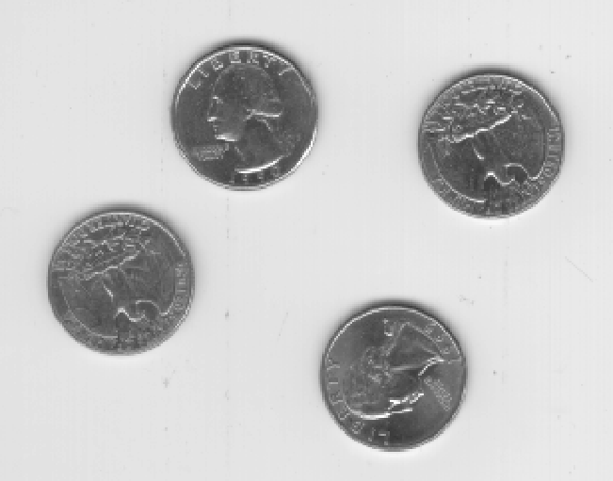
Compute Dart Values
A dart in an image is a transition from one pixel to another.
Compute from every pixel the change of the pixel value to every neighbor (N,E,S,W)

Slide 22
Phase 3: Implementation

Slide 23
Build Initial CP Level
Computation of the dart indices
Example South Indices:
Added by 4 inside the image. On the border it is only added by 3 (because the west dart is missing)
Also exceptions in the first row and the last row (missing north dart)
Additional exceptions for the corners

Slide 24
Build Initial CP Level
Computation of the next index:
one row:
repmat([2; 2; -1; -3], width-2, 1)
middle of the image:
repmat(
[next_darts_one_row; 1; 1; -2; 2; -1; -1],
height-2, 1)
Special cases for first and last row
d | s(d) | s(d)-d

Slide 25
Build Initial CP Level
Involution a
cm.involution(N) = S
cm.involution(E) = W
…
Previous Dart r
cm.prev(cm.next) = 1:num_darts

Slide 26
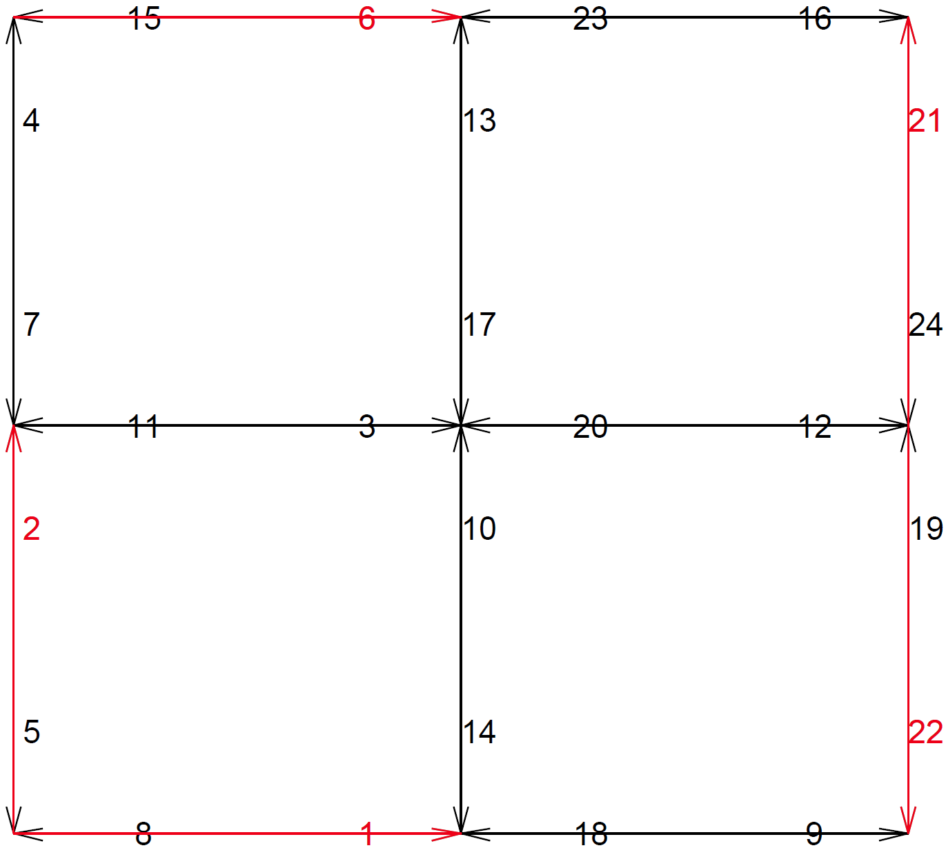
Build Initial CP Level
Some Examples:

Slide 27
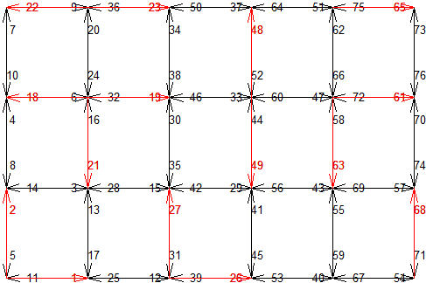
Build Initial CP Level
Some Examples:

Slide 28
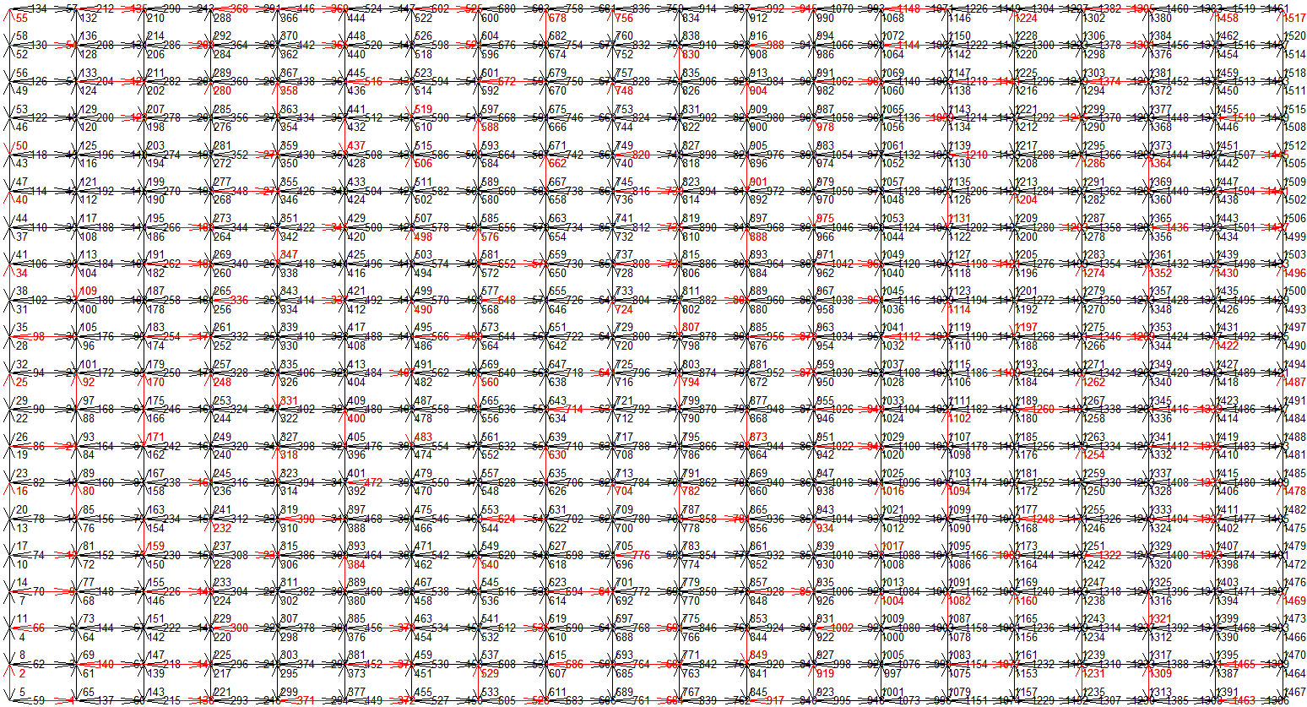
Build Initial CP Level
Some Examples:

Slide 29
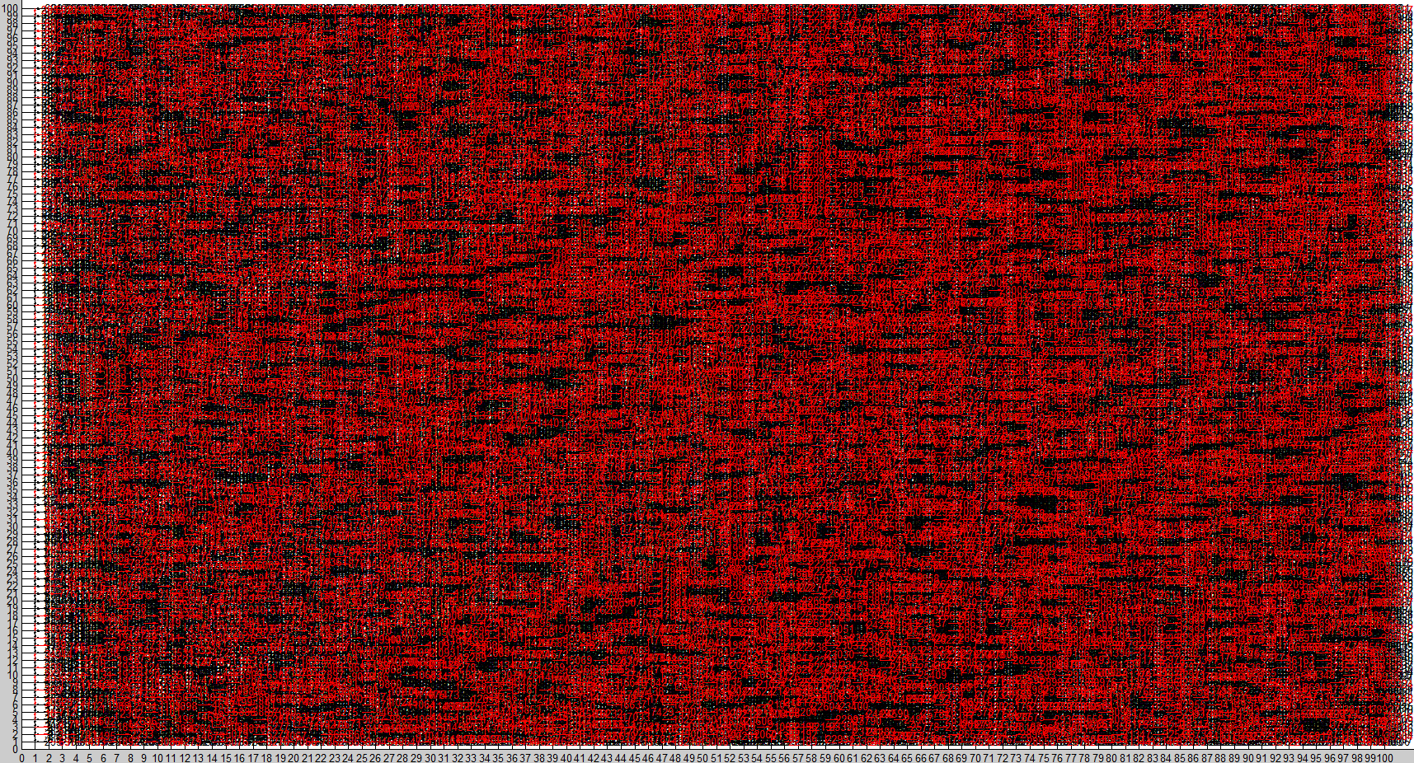
Build Initial CP Level
Some Examples:

Slide 30
Phase 3: Implementation

Slide 31
CP Creation
Contract Darts
Simplify Level
Compute Contraction Kernel

Slide 32
CP Creation
Sort the darts by its values
Add dart to contraction kernel if:
Not self loop
Not pending edge
Contract Darts
Simplify Level
Compute Contraction Kernel

Slide 33
CP Creation
Greedy: Assign next best Dart For Contraction Kernel
Contract Darts
Simplify Level
Compute Contraction Kernel

Slide 34
CP Creation
Get the involution of the dart
Contract Darts
Simplify Level
Compute Contraction Kernel

Slide 35
CP Creation
And the orbit of the involution
Contract Darts
Simplify Level
Compute Contraction Kernel

Slide 36
CP Creation
Now remove the involution of the involution orbit from the set of valid darts
Contract Darts
Simplify Level
Compute Contraction Kernel

Slide 37
CP Creation
Contract Darts
Simplify Level
Compute Contraction Kernel
Now get the orbit of the dart

Slide 38
CP Creation
Contract Darts
Simplify Level
Compute Contraction Kernel
And remove its involution (except darts that are already in the kernel)

Slide 39
CP Creation
Exceptions:
Self loops
Pending edges
Contract Darts
Simplify Level
Compute Contraction Kernel

Slide 40
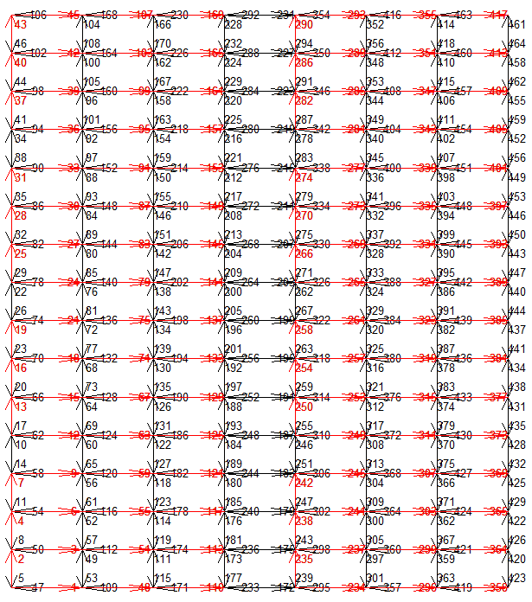

CP Creation
Examples: Checkerboard

Slide 41
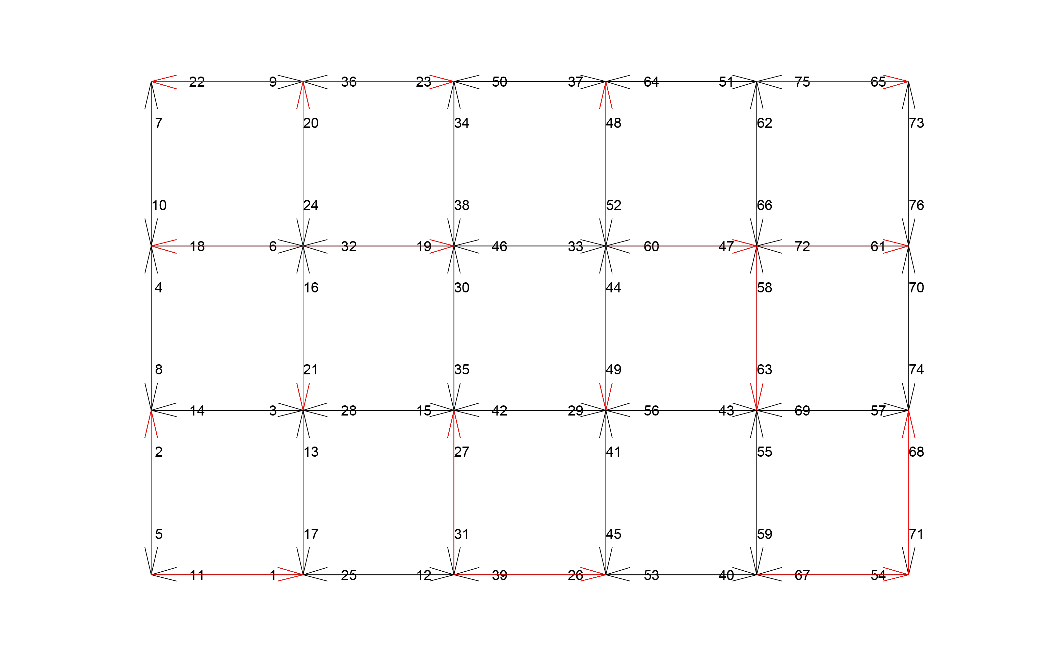
CP Creation
Examples: Random 4x6

Slide 42
CP Creation
Contract Darts
Simplify Level
Compute Contraction Kernel

Slide 43
CP Creation
Recap: Contract Darts
s
b
e
-x
d
a
x
c
darts | a | b | c | d | e | x | -x
s | x | a | d | e | -x | b | c
s’ | c | a | d | e | b | b | c
Contract Darts
Simplify Level
Compute Contraction Kernel

Slide 44
CP Creation
Recap: Contract Darts
s
s’
b
e
b
e
-x
d
d
a
x
a
c
c
darts | a | b | c | d | e | x | -x
s | x | a | d | e | -x | b | c
s’ | c | a | d | e | b | b | c
Contract Darts
Simplify Level
Compute Contraction Kernel

Slide 45
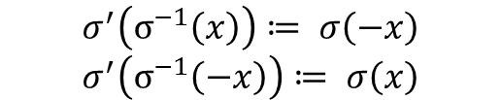
CP Creation
Recap: Contract Darts
s
s’
b
e
b
e
-x
d
d
a
x
a
c
c
darts | a | b | c | d | e | x | -x
s | x | a | d | e | -x | b | c
s’ | c | a | d | e | b | b | c
Contract Darts
Simplify Level
Compute Contraction Kernel
$$σ^{′}\left(σ^{−1}\left(x\right)\right)≔ σ\left(−x\right)$$
$$σ^{′}\left(σ^{−1}\left(−x\right)\right)≔ σ\left(x\right)$$

Slide 46
CP Creation
Contract Darts
Simplify Level
Compute Contraction Kernel

Slide 47
CP Creation
When contracting darts double edges and self-direct-loops are created. By removing these darts the pyramid is easier to read and faster to compute.
Contract Darts
Simplify Level
Compute Contraction Kernel

Slide 48
CP Creation
Check if the face of a dart has less than 2 darts:
Get face of this dart
Contract Darts
Simplify Level
Compute Contraction Kernel

Slide 49
CP Creation
Check if the face of a dart has less than 2 darts:
More than 2 darts!
Add all darts as valid
Contract Darts
Simplify Level
Compute Contraction Kernel

Slide 50
CP Creation
Check if the face of a dart has less than 2 darts:
Get face of this dart
Contract Darts
Simplify Level
Compute Contraction Kernel

Slide 51
CP Creation
Check if the face of a dart has less than 2 darts:
Contract Darts
Simplify Level
Compute Contraction Kernel
Number of darts in face is 2
→ can be removed!

Slide 52
CP Creation
Special cases for removal:
Pending Edge (2 cases)
Self Loops (2 cases)
Self-Direct-Loops
Contract Darts
Simplify Level
Compute Contraction Kernel

Slide 53
Development Phases
Phase 1:
Existing Work
Phase 2:
Meet the Maps
Phase 3:
Implementation
Phase 4:
Results

Slide 54
Phase 4: Results
DEMO

Slide 55
Literatur
[Tor] Torres, Fuensanta, and Walter G. Kropatsch. "Canonical Encoding of the Combinatorial Pyramid.“
[Bru01] Brun, Luc, and Walter Kropatsch. "Introduction to combinatorial pyramids." Digital and image geometry. Springer Berlin Heidelberg, 2001.
[Bru03] Brun, Luc, and Walter Kropatsch. "Contraction kernels and combinatorial maps." Pattern Recognition Letters 24.8 (2003): 1051-1057.

